Slide 1
Floating-Point Division
Floating-point division requires that the exponents be subtracted and the mantissas divided.
The mantissa division is done as in fixed-point except that the dividend has a single-precision mantissa that is placed in the AC .
Remember that the mantissa dividend is a fraction and not an integer.
The division algorithm can be subdivided into five parts:
1. Check for zeros.
2. Initialize registers and evaluate the sign.
3. Align the dividend.
4. Subtract the exponents.
5. Divide the mantissas

Slide 2
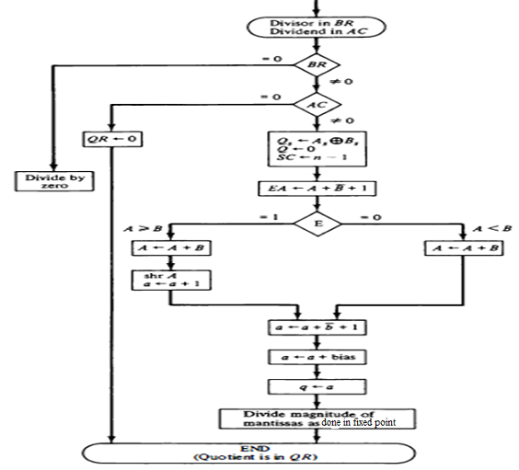
The flowchart for floating-point division

Slide 3
The two operands are checked for zero. If the divisor is zero, it indicates an attempt to divide by zero, which is an illegal operation. The operation is terminated with an error message.
An alternative procedure would be to set the quotient in QR to the most positive number possible (if the dividend is positive) or to the most negative possible (if the dividend is negative). If the dividend in AC is zero, the quotient in QR is made zero and the operation terminates.
If the operands are not zero, we proceed to determine the sign of the quotient and store it in Qs . The sign of the dividend in As is left unchanged to be the sign of the remainder. The Q register is cleared and the sequence counter SC is set to a number equal to the number of bits in the quotient.
The dividend alignment is similar to the divide-overflow check in the fixed-point operation.
The proper alignment requires that the fraction dividend be smaller than the divisor. The two fractions are compared by a subtraction test.
The carry in E determines their relative magnitude. The dividend fraction is restored to its original value by adding the divisor. If A >=B, it is necessary to shift A once to the right and increment the dividend exponent.
Since both operands are normalized, this alignment ensures that A < B .

Slide 4
Next, the divisor exponent is subtracted from the dividend exponent. Since both exponents were originally biased, the subtraction operation gives the difference without the bias. The bias is then added and the result transferred into q because the quotient is formed in QR.
The magnitudes of the mantissas are divided as in the fixed-point case. After the operation, the mantissa quotient resides in Q and the remainder in A. The floating-point quotient is already normalized and resides in QR.
The exponent of the remainder should be the same as the exponent of the dividend.

